Slide 1
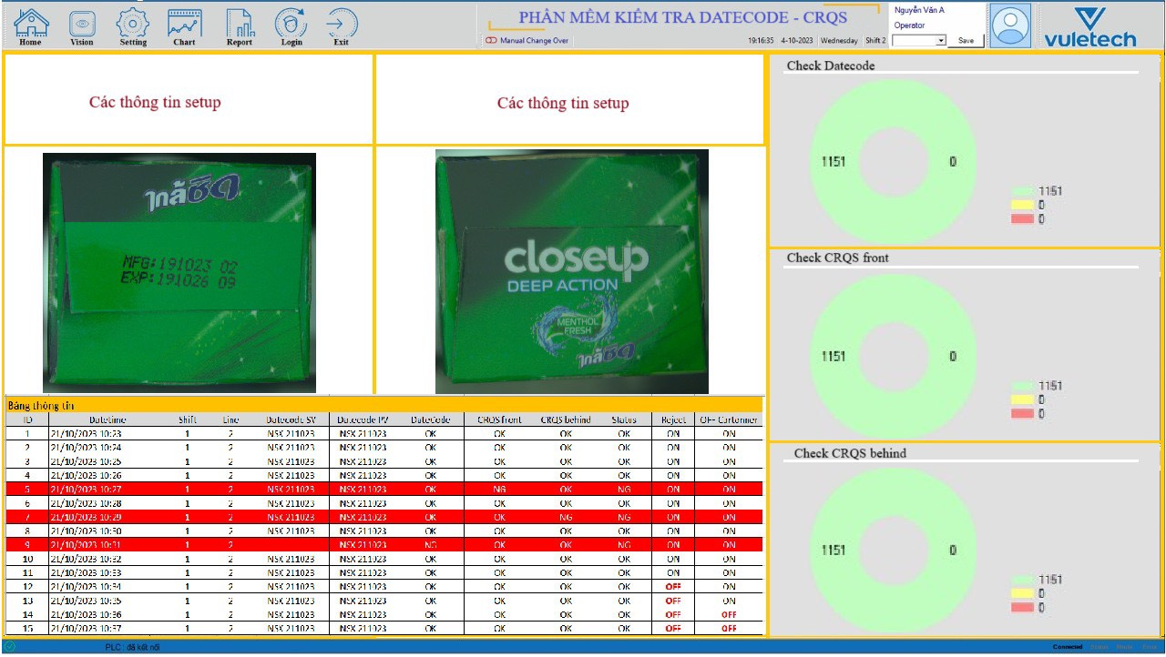

Slide 2



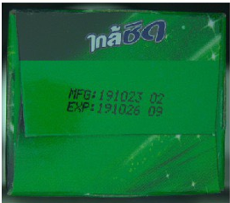
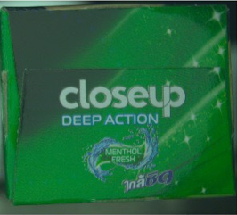
DEoC of Cartoner – Line 2 Oral care
FGs code:
69786146
Datecode:
HSD 131126 2 HH
P/S TP ANTI CAVITY Y23 60X100G
Operator:
Nguyễn Văn A
OK
Shift Quality
Produced: 150,000
90%
Logout
Home
Datecode
Front CRQS
Back CRQS
Front Camera
Masterdata
Total:
Total:
Total:
Report
Good:
Good:
Good:
Not Good:
Not Good:
Not Good:
Setting
About
Running
Reject
Running
Reject
Running
Reject
Sp lỗi liên tiếp
5
Enable
Sp lỗi liên tiếp
5
Disable
Sp lỗi liên tiếp
5
Enable
Result:
Back Camera
Result:
HSD 131126 2 13:22
Not Good
Result:
Good
Status:
PASS
Status:
FAIL
Status:
PASS
ID | Datetime | Datecode | Image Fail | Date code | CRQS 1 | CRQS2 | Status | OP name
1 |  |  |  | OK | OK | NG | NG | Nguyen Van A
2 |  |  |  | NG | NG | NG | NG | Nguyen Van A
3
4

Slide 3
DEoC of Cartoner – Line 2 Oral care
FGs code:
69786146
Datecode:
HSD 131126 2 HH
DIGITAL EYE
Of the consumer
P/S TP ANTI CAVITY Y23 60X100G
Operator:
Nguyễn Văn A
Shift Quality
Save
Produced: 150,000
90%
Home
Shift Quality = tổng pcs PASS/tổng pcs sản xuất được
Front Camera
Datecode
Front CRQS
Back CRQS
Masterdata
Total:
Total:
Total:
Report
Good:
Good:
Good:
Not Good:
Not Good:
Not Good:
Setting
About
Trigger
Reject
Trigger
Reject
Trigger
Reject
Enable
Enable
Enable
Disable
Enable
Enable
Result:
Back Camera
Result:
HSD 131126 2 13:22
Not Good
Result:
Good
Status:
PASS
Status:
FAIL
Status:
PASS
ID | Datetime | Datecode | Image Fail
1
2
3
4
Nội dung bảng này là để OP có thể check những hộp vừa reject ra có hình lỗi như thế nào

